Slide 1
Coordinator (Grades 9-12)
2024-2025
Notes:
2021-2022

Slide 2
PFE Goals
Ease isolation and loneliness of the elderly by promoting connection.
For students and mentors to create intergenerational relationships and experience the blessing of service.
Support Adventist Education by awarding tuition scholarship

Slide 3
SFFC Foundation
The SFFC Foundation is a nonprofit organization based in Nashville, TN. Our current initiatives include the PFE Scholarship, Nourish Grants for individuals/families, and Dream Grants to support programs created by other nonprofits.
Administration Team
Ashley Beisiegel Jackie Downs
K-8 Program Officer 9-12 Program Officer
Office Number: (615) 675-0450

Slide 4
Coordinator Job Description
Manage PFE student selection process.
Provide orientation for students and parents before visits begin. (PowerPoint available)
Confirm that student is matched with a mentor in compliance with PFE guidelines.
Provide a Mentor Orientation. (PowerPoint available)
Review reflections weekly -provide needed feedback to student.
Monthly check-ins with mentors.
Communicate with SFFC Foundation as needed for support.

Slide 5
Student Selection
Students and parents who are passionate about serving others.
Students who would benefit from a positive intergenerational connection.
Students/parents able to commit to consistent, weekly visits.
PFE is not a financial needs-based program.

Slide 6
Student/Parent Orientation
Student and parent MUST attend PFE orientation prior to visits beginning.
(even if they have participated in previous years)
Orientation:
Does not count as scholarship time and will not be paid.
Must explain:
Expectations of students in PFE programming.
The importance of choosing the correct mentor.
The application and reflection processes.
Eligibility/ineligibility for receiving scholarship (all or nothing)

Slide 7
Student-Mentor Matches
PFE was designed to ease senior isolation. An appropriate mentor is a cognitively healthy, older adult (must be 55+) or someone with a disability who could use company and/or light assistance around the home.
Choosing a Mentor:
Families can choose their own mentors (1 for each child) or you may provide a list of suggested mentors from your community.
Non-negotiable criteria:
No nursing home residents.
Cognitively healthy: Individuals who are suffering from Alzheimer’s or Dementia are not eligible mentor candidates for PFE.
A mentor must be able to commit to consistent, weekly visits all year.
Students may not be matched with a relative by any degree.

Slide 8
Mentor Orientation & Check-ins
All mentors must attend a Mentor Orientation at the beginning of the year before students start visiting. It can be in conjunction with PFE 9-12 Student/Parent Orientation. (PowerPoint available)
Mentors must submit their Mentor Survey
Mentor check-ins should happen every month to confirm that student/mentor PFE visits are meeting expectations.

Slide 9
Safety
In order to keep each student safe while visiting:
Parents of students in grades 9-12 will decide if their child may visit unsupervised.
Parents are ultimately responsible for their child’s safety.
Parents are responsible for visit transportation.
Make sure you are complying with any of your conference’s policies for student safety, including background checks if applicable.

Slide 10
Unacceptable Activities
Reflections with these activities should not be approved:
Watching TV
Being on your phone or ignoring your mentor
Visiting your mentor’s home while he/she is away
Mentor's being paired with more than one student
Virtual visits
Time spent at a school event, cleaning church/school, assisting in classroom, entertainment venue, or during Sabbath hours

Slide 11
Reflections
Reflections should be submitted online during or within 24 hours of each visit. Late reflections should be rejected.
Mobile App available– encourage students to utilize mobile devices to complete reflection with their mentor the last few minutes of their visit.
Disposition reflections weekly. Students will be able to edit rejected reflections, then re-submit for approval (but only within a 2-week window of original submission)
Email notifications are sent to coordinator and student any time there is a reflection transaction.
If a student has tech issues they must contact you immediately. Waiting to notify you of issues will not be an excuse for late submissions.

Slide 12
Coordinator Dashboard

Slide 13
Reflection List

Slide 14
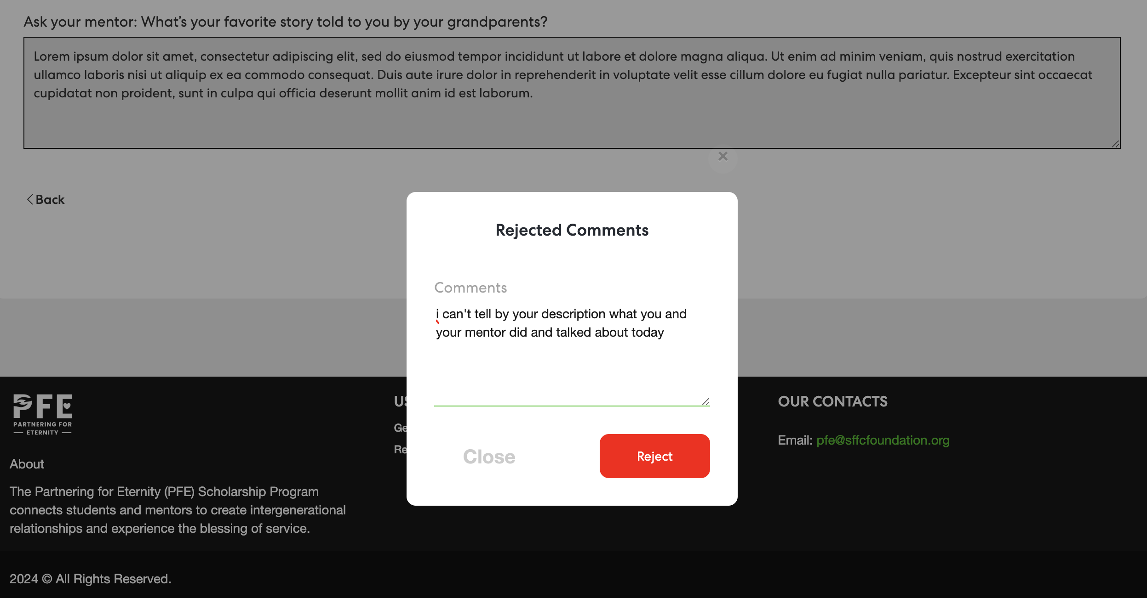
Reflection Log

Slide 15
Fall Term Visits: Aug. 18- Dec. 31 Reflections must be dispositioned by January 6 Scholarships processed: Jan. 7 Spring Term Visits: Jan. 1- May 17 Reflections must be dispositioned by May 19 Scholarships processed: May 20
Dates & Deadlines

Slide 16
Scholarship Payments
Scholarship funded visits can begin once all trainings (student and mentor) are complete. The reporting website will automatically track visits based on approved reflections.
Students that do not complete all visits and reflections will not receive scholarship payment.
Scholarship payments will automatically be sent to your school (January/May).
SFFC Foundation funds 70%, your school fundraises 30% of each PFE scholarship.

Slide 17
Surveys
The SFFC Foundation Board is excited to hear your PFE success stories!
Throughout the year, we will send surveys to PFE participants to help us evaluate current programming. This will help us adjust programming to improve PFE.
Continued eligibility in PFE is dependent upon survey completion.

Slide 18
PFE Resources sffcfoundation.org/pfe
PowerPoint Presentations:
Orientations (Mentor, Student/Parent, Coordinator)
Loss of Mentor (when a mentor dies)
Information Packets
Coordinator, Student, Mentor
Ideas for student and mentors for visit activities

Slide 19
Social Media
PFE eNewsletter
Sent monthly via email to share stories, activity ideas, and upcoming dates
Can be found at https://sffcfoundation.org/pfe/news
Facebook Page: Partnering for Eternity
Request to join our FB page and once you are approved, please post any comments, questions, or great ideas you would like to share or discuss with PFE administration or other PFE schools.

